Slide 1


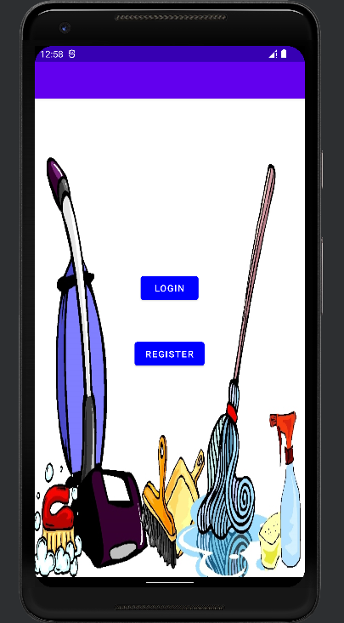
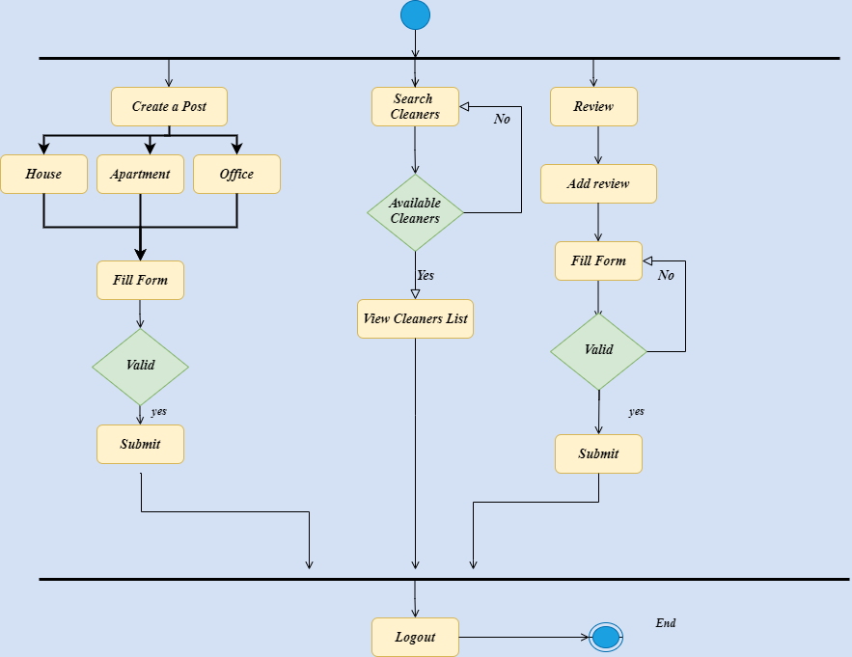
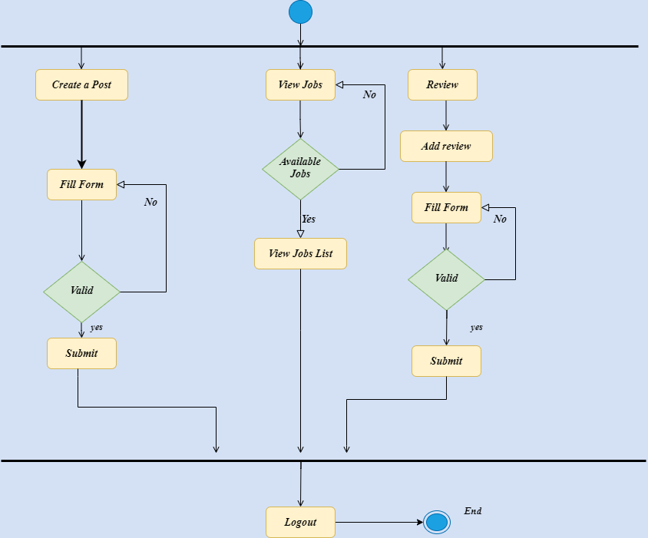
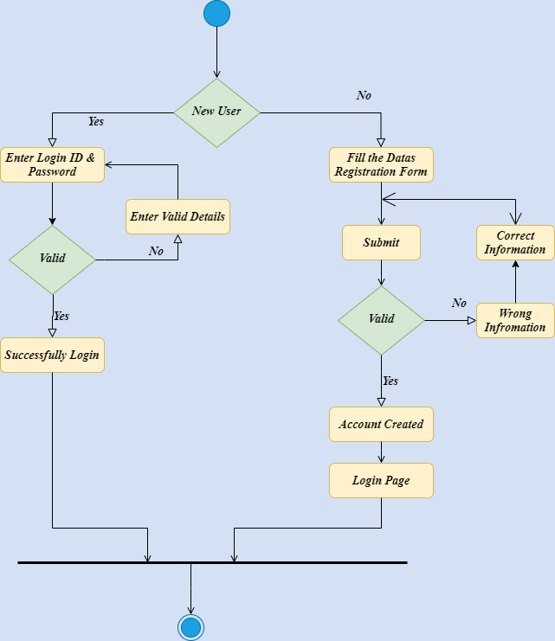
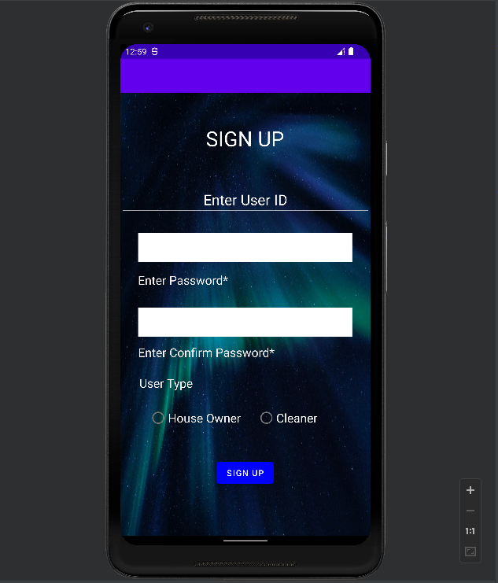
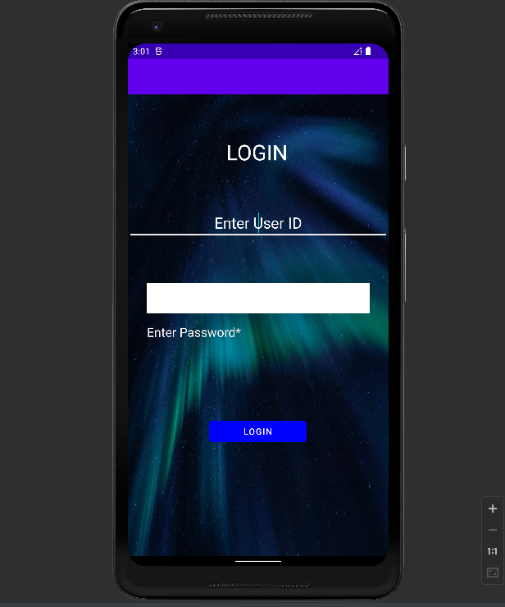
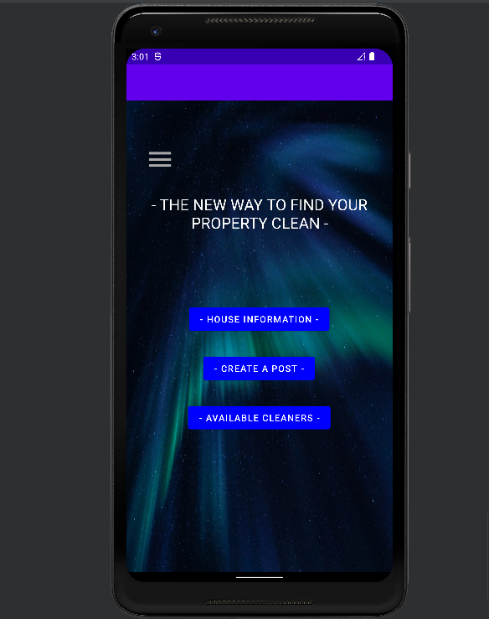
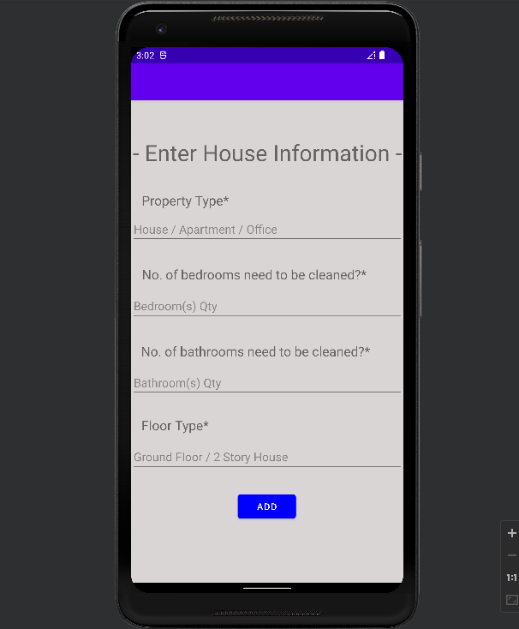
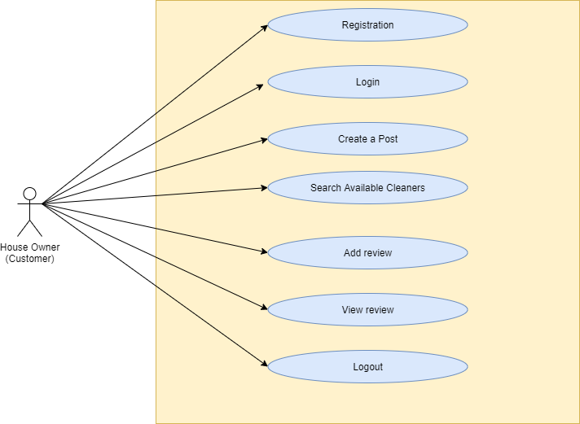
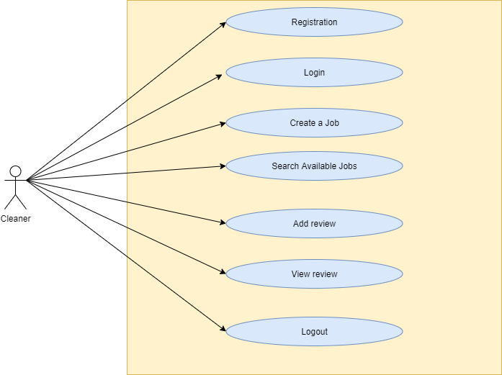
Mobile Application Development
CO666
Diagrams
Results
INTRODUCTION
Technology has transformed industries by introducing innovative tools and methodologies, particularly in the service industry. The internet has become an invaluable tool for seeking services, businesses, and products, offering speed and ease. This assignment focuses on creating a mobile application for house owners and cleaners to discover top-notch service providers and find job opportunities. The application ensures swift access to specific requirements and allows users to peruse and submit reviews, creating a feedback loop that benefits both parties. Newcomers can rely on these reviews to inform their decisions and continue their tasks.
Customer Entity Diagram
Cleaner Entity Diagram
Mobile App Development Tools and Technology
Development Tools – Android Studio IDE
I'm choosing the mobile app development tool Android Studio Software, which will ultimately decide the quality and capabilities of my mobile application. Before I select a mobile app development tool, I carefully analyze the features and requirements of my application and then I pick up the Android Studio to develop my project.
Technology – Java
Java- Java is arguably the most popular language for building Android Applications. About this object-oriented programming language, we've all heard enough. The standard language for creating Android applications is this user-friendly and highly secure one. Java has a wealth of open-source frameworks, great documentation, and community support, all of which enable developers to quickly and effectively create a variety of Android applications.
Logon & Register Activity Diagram
Conclusion
The mobile application can help House owners and cleaners to work with the system and improve their job and move to the new systems as they got knowledge about it. We believe this makes these applications most convenient for the practice and learning of the elements they deal with.
Customer Use case Diagram
Cleaner Use case Diagram

